Slide 1
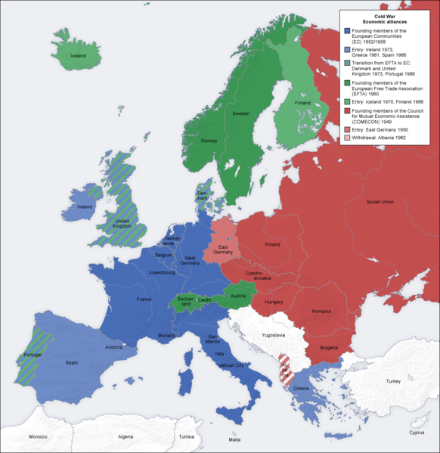
Source: https://commons.wikimedia.org/wiki/File:Cold_war_europe_economic_alliances_map_en.png
Notes:
Only need to explain that the countries in red were behind the Iron Curtain and the others were not

Slide 2
Source: https://commons.wikimedia.org/wiki/File:Political_Map_of_Europe-en.svg

